Slide 1
Welcome to Week-7
Advanced Programming in Python
By Engr. Imran Khan
Instructor

Slide 2
Tutorial Content
Overview of Python Libraries for Data Scientists
Reading Data; Selecting and Filtering the Data; Data manipulation, sorting, grouping, rearranging
Plotting the data
Descriptive statistics
Inferential statistics

Slide 3
Python Libraries for Data Science
Many popular Python too libraries:
NumPy
SciPy
Pandas
SciKit-Learn
Visualization libraries
matplotlib
Seaborn
and many more …
All these libraries are installed must be installed in your laptop

Slide 4

Python Libraries for Data Science
NumPy:
introduces objects for multidimensional arrays and matrices, as well as functions that allow to easily perform advanced mathematical and statistical operations on those objects
provides vectorization of mathematical operations on arrays and matrices which significantly improves the performance
many other python libraries are built on NumPy
Link: http://www.numpy.org/

Slide 5

Python Libraries for Data Science
SciPy:
collection of algorithms for linear algebra, differential equations, numerical integration, optimization, statistics and more
Open source
Used for mathematics, science, and engineering
Link: https://www.scipy.org/scipylib/

Slide 6

Python Libraries for Data Science
Pandas:
adds data structures and tools designed to work with table-like data (similar to Series and Data Frames)
provides tools for data manipulation: reshaping, merging, sorting, slicing, aggregation etc.
allows handling missing data
Link: http://pandas.pydata.org/

Slide 7

Python Libraries for Data Science
SciKit-Learn:
provides machine learning algorithms: classification, regression, clustering, model validation etc.
built on NumPy, SciPy and matplotlib
Link: http://scikit-learn.org/

Slide 8

Python Libraries for Data Science
matplotlib:
python 2D plotting library which produces publication quality figures in a variety of hardcopy formats
a set of functionalities similar to those of MATLAB
line plots, scatter plots, barcharts, histograms, pie charts etc.
relatively low-level; some effort needed to create advanced visualization
Link: https://matplotlib.org/

Slide 9
Python Libraries for Data Science
Seaborn:
based on matplotlib
provides high level interface for drawing attractive statistical graphics
Similar (in style) to the popular ggplot2 library in R
Link: https://seaborn.pydata.org/

Slide 10
Loading Python Libraries
In [ ]:
#Import Python Libraries
import numpy as np
import scipy as sp
import pandas as pd
import matplotlib as mpl
import seaborn as sns
Press Shift+Enter to execute the jupyter cell

Slide 11
What is Numpy?
Numpy, Scipy, and Matplotlib provide MATLAB-like functionality in python.
Numpy Features:
Typed multidimentional arrays (matrices)
Fast numerical computations (matrix math)
High-level math functions

Slide 12
Why do we need NumPy
Let’s see for ourselves!

Slide 13
Why do we need NumPy
Python does numerical computations slowly.
1000 x 1000 matrix multiply
Python triple loop takes > 10 min.
Numpy takes ~0.03 seconds

Slide 14
NumPy Overview
Arrays
Shaping and transposition
Mathematical Operations
Indexing and slicing
Broadcasting

Slide 15
Arrays
Structured lists of numbers.
Vectors
Matrices
Images
Tensors
ConvNets

Slide 16

Arrays
Structured lists of numbers.
Vectors
Matrices
Images
Tensors
ConvNets
$$\left[\begin{matrix}p_{x} \\ p_{y} \\ p_{z}\end{matrix}\right]$$
$$\left[\begin{matrix}a_{11} & ⋯ & a_{1n} \\ ⋮ & ⋱ & ⋮ \\ a_{m1} & ⋯ & a_{mn}\end{matrix}\right]$$

Slide 17

Arrays
Structured lists of numbers.
Vectors
Matrices
Images
Tensors
ConvNets

Slide 18
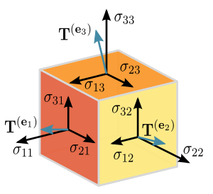
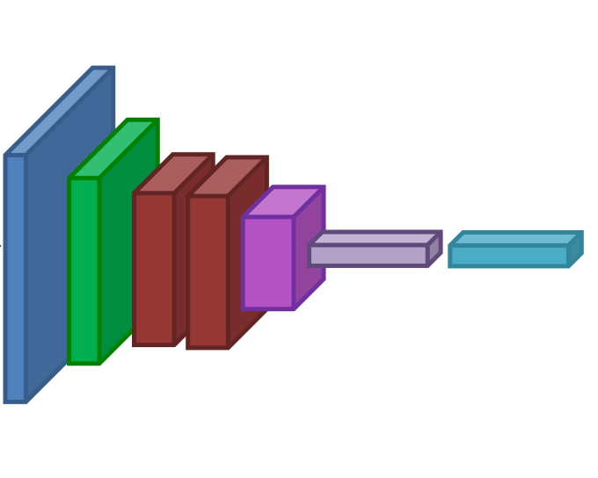
Arrays
Structured lists of numbers.
Vectors
Matrices
Images
Tensors
ConvNets

Slide 19
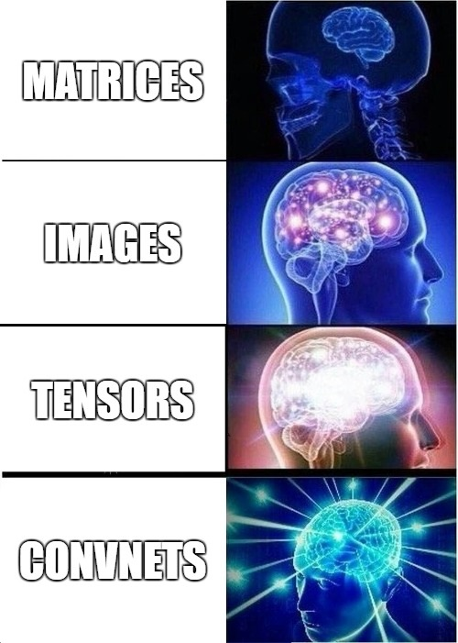
Arrays
Structured lists of numbers.
Vectors
Matrices
Images
Tensors
ConvNets

Slide 20
Arrays, Basic Properties
import numpy as np
a = np.array([[1,2,3],[4,5,6]],dtype=np.float32)
print a.ndim, a.shape, a.dtype
Arrays can have any number of dimensions, including zero (a scalar).
Arrays are typed: np.uint8, np.int64, np.float32, np.float64
Arrays are dense. Each element of the array exists and has the same type.

Slide 21
Arrays, creation
np.ones, np.zeros
np.arange
np.concatenate
np.astype
np.zeros_like, np.ones_like
np.random.random

Slide 22
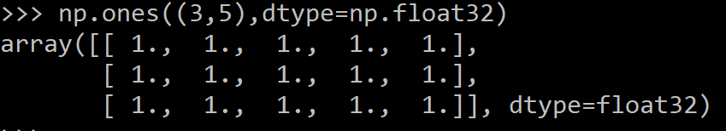
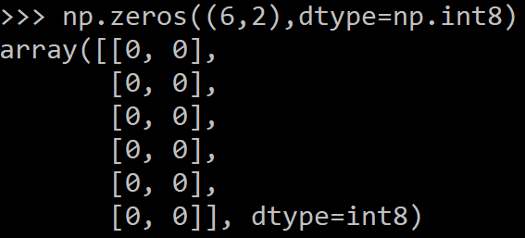
Arrays, creation
np.ones, np.zeros
np.arange
np.concatenate
np.astype
np.zeros_like, np.ones_like
np.random.random

Slide 23

Arrays, creation
np.ones, np.zeros
np.arange
np.concatenate
np.astype
np.zeros_like, np.ones_like
np.random.random

Slide 24
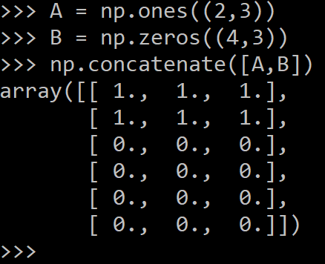
Arrays, creation
np.ones, np.zeros
np.arange
np.concatenate
np.astype
np.zeros_like, np.ones_like
np.random.random

Slide 25
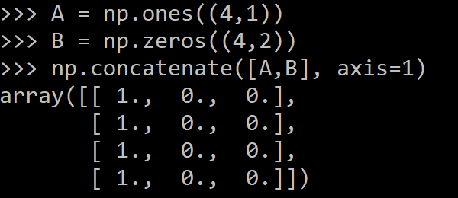
Arrays, creation
np.ones, np.zeros
np.arange
np.concatenate
np.astype
np.zeros_like, np.ones_like
np.random.random

Slide 26
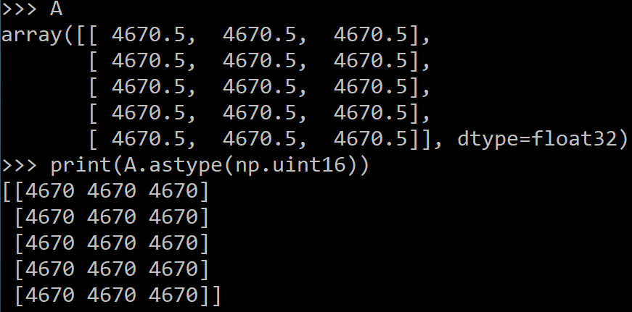
Arrays, creation
np.ones, np.zeros
np.arange
np.concatenate
np.astype
np.zeros_like, np.ones_like
np.random.random

Slide 27
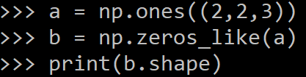
Arrays, creation
np.ones, np.zeros
np.arange
np.concatenate
np.astype
np.zeros_like, np.ones_like
np.random.random

Slide 28
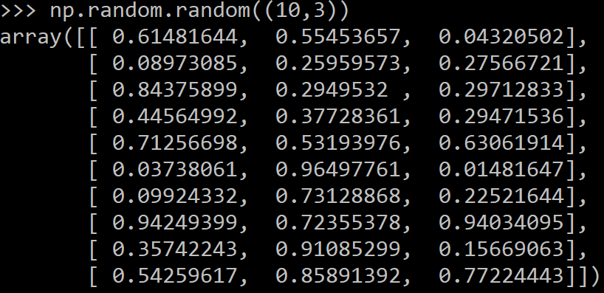
Arrays, creation
np.ones, np.zeros
np.arange
np.concatenate
np.astype
np.zeros_like, np.ones_like
np.random.random

Slide 29
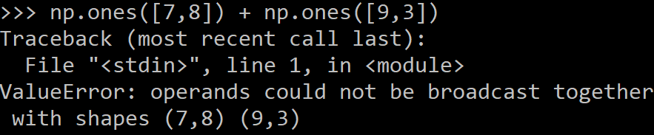
Arrays, danger zone
Must be dense, no holes.
Must be one type
Cannot combine arrays of different shape

Slide 30
Shaping
a = np.array([1,2,3,4,5,6])
a = a.reshape(3,2)
a = a.reshape(2,-1)
a = a.ravel()
Total number of elements cannot change.
Use -1 to infer axis shape
Row-major by default (MATLAB is column-major)

Slide 31
Return values
Numpy functions return either views or copies.
Views share data with the original array, like references in Java/C++. Altering entries of a view, changes the same entries in the original.
The numpy documentation says which functions return views or copies
Np.copy, np.view make explicit copies and views.

Slide 32
Transposition
a = np.arange(10).reshape(5,2)
a = a.transpose((1,0))

Slide 33
Saving and loading arrays
np.savez(‘data.npz’, a=a)
data = np.load(‘data.npz’)
a = data[‘a’]
NPZ files can hold multiple arrays
np.savez_compressed similar.

Slide 34

Image arrays
Images are 3D arrays: width, height, and channels
Common image formats:
height x width x RGB (band-interleaved)
height x width (band-sequential)
Gotchas:
Channels may also be BGR (OpenCV does this)
May be [width x height], not [height x width]

Slide 35
Saving and Loading Images
SciPy: skimage.io.imread,skimage.io.imsave
height x width x RGB
PIL / Pillow: PIL.Image.open, Image.save
width x height x RGB
OpenCV: cv2.imread, cv2.imwrite
height x width x BGR

Slide 36
Recap
We just saw how to create arrays, reshape them, and permute axes
Questions so far?

Slide 37
Recap
We just saw how to create arrays, reshape them, and permute axes
Questions so far?
Now: let’s do some math

Slide 38
Mathematical operators
Arithmetic operations are element-wise
Logical operator return a bool array
In place operations modify the array

Slide 39
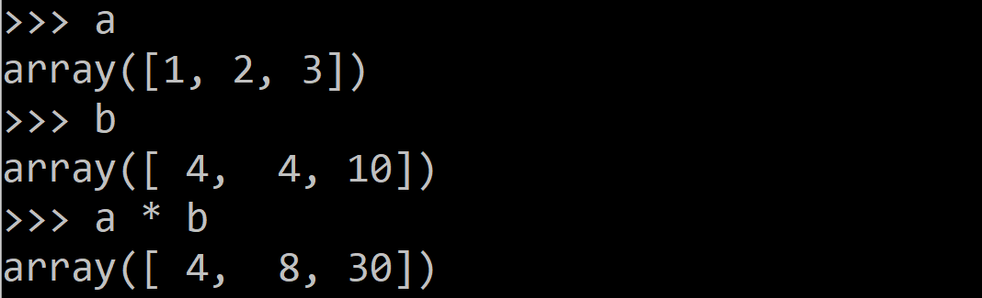
Mathematical operators
Arithmetic operations are element-wise
Logical operator return a bool array
In place operations modify the array

Slide 40
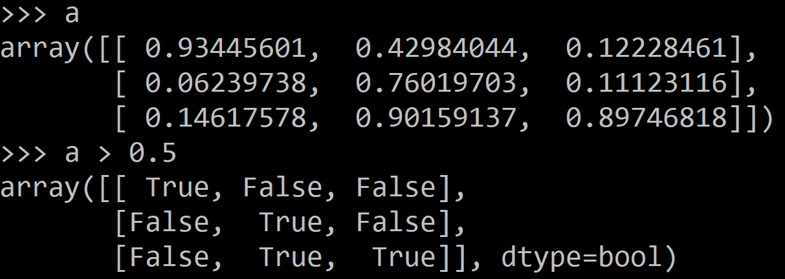
Mathematical operators
Arithmetic operations are element-wise
Logical operator return a bool array
In place operations modify the array

Slide 41
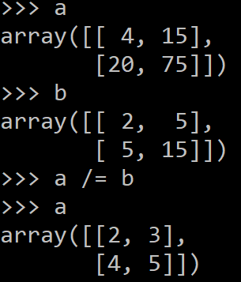
Mathematical operators
Arithmetic operations are element-wise
Logical operator return a bool array
In place operations modify the array

Slide 42
Math, upcasting
Just as in Python and Java, the result of a math operator is cast to the more general or precise datatype.
uint64 + uint16 => uint64
float32 / int32 => float32
Warning: upcasting does not prevent overflow/underflow. You must manually cast first.
Use case: images often stored as uint8. You should convert to float32 or float64 before doing math.

Slide 43
Math, universal functions
Also called ufuncs
Element-wise
Examples:
np.exp
np.sqrt
np.sin
np.cos
np.isnan

Slide 44
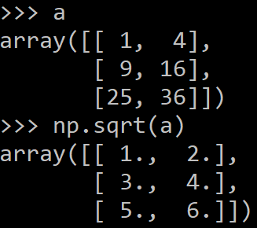
Math, universal functions
Also called ufuncs
Element-wise
Examples:
np.exp
np.sqrt
np.sin
np.cos
np.isnan

Slide 45
Indexing
x[0,0] # top-left element
x[0,-1] # first row, last column
x[0,:] # first row (many entries)
x[:,0] # first column (many entries)
Notes:
Zero-indexing
Multi-dimensional indices are comma-separated (i.e., a tuple)

Slide 46
Indexing, slices and arrays
I[1:-1,1:-1] # select all but one-pixel border
I = I[:,:,::-1] # swap channel order
I[I<10] = 0 # set dark pixels to black
I[[1,3], :] # select 2nd and 4th row
Slices are views. Writing to a slice overwrites the original array.
Can also index by a list or boolean array.

Slide 47
Python Slicing
Syntax: start:stop:step
a = list(range(10))
a[:3] # indices 0, 1, 2
a[-3:] # indices 7, 8, 9
a[3:8:2] # indices 3, 5, 7
a[4:1:-1] # indices 4, 3, 2 (this one is tricky)

Slide 48
Axes
a.sum() # sum all entries
a.sum(axis=0) # sum over rows
a.sum(axis=1) # sum over columns
a.sum(axis=1, keepdims=True)
Use the axis parameter to control which axis NumPy operates on
Typically, the axis specified will disappear, keepdims keeps all dimensions

Slide 49
Broadcasting
a = a + 1 # add one to every element
When operating on multiple arrays, broadcasting rules are used.
Each dimension must match, from right-to-left
Dimensions of size 1 will broadcast (as if the value was repeated).
Otherwise, the dimension must have the same shape.
Extra dimensions of size 1 are added to the left as needed.

Slide 50
Broadcasting example
Suppose we want to add a color value to an image
a.shape is 100, 200, 3
b.shape is 3
a + b will pad b with two extra dimensions so it has an effective shape of 1 x 1 x 3.
So, the addition will broadcast over the first and second dimensions.

Slide 51
Broadcasting failures
If a.shape is 100, 200, 3 but b.shape is 4 then a + b will fail. The trailing dimensions must have the same shape (or be 1)

Slide 52
Tips to avoid bugs
Know what your datatypes are.
Check whether you have a view or a copy.
Use matplotlib for sanity checks.
Use pdb to check each step of your computation.
Know np.dot vs np.mult.

Slide 53
Reading data using pandas
In [ ]:
#Read csv file
df = pd.read_csv(“file.csv")
Note: The above command has many optional arguments to fine-tune the data import process.
There is a number of pandas commands to read other data formats:
pd.read_excel('myfile.xlsx',sheet_name='Sheet1', index_col=None, na_values=['NA'])
pd.read_stata('myfile.dta')
pd.read_sas('myfile.sas7bdat')
pd.read_hdf('myfile.h5','df')

Slide 54
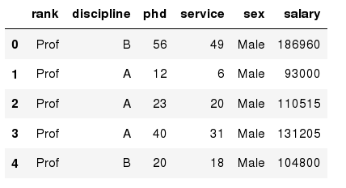
Exploring data frames
In [3]:
#List first 5 records
df.head()
Out[3]:

Slide 55
Data Frame data types
Pandas Type | Native Python Type | Description
object | string | The most general dtype. Will be assigned to your column if column has mixed types (numbers and strings).
int64 | int | Numeric characters. 64 refers to the memory allocated to hold this character.
float64 | float | Numeric characters with decimals. If a column contains numbers and NaNs(see below), pandas will default to float64, in case your missing value has a decimal.
datetime64, timedelta[ns] | N/A (but see the datetime module in Python’s standard library) | Values meant to hold time data. Look into these for time series experiments.

Slide 56
Data Frame data types
In [4]:
#Check a particular column type
df[‘'].dtype
Out[4]: dtype('int64')
In [5]:
#Check types for all the columns
df.dtypes
Out[4]:
object
object
int64
int64
object
int64
rank
discipline
phd
service
sex
salary
dtype: object

Slide 57
Data Frames attributes
Python objects have attributes and methods.
df.attribute | description
dtypes | list the types of the columns
columns | list the column names
axes | list the row labels and column names
ndim | number of dimensions
size | number of elements
shape | return a tuple representing the dimensionality
values | numpy representation of the data

Slide 58
Hands-on exercises
Find how many records this data frame has;
How many elements are there?
What are the column names?
What types of columns we have in this data frame?

Slide 59
Data Frames methods
Unlike attributes, python methods have parenthesis.
All attributes and methods can be listed with a dir() function: dir(df)
df.method() | description
head( [n] ), tail( [n] ) | first/last n rows
describe() | generate descriptive statistics (for numeric columns only)
max(), min() | return max/min values for all numeric columns
mean(), median() | return mean/median values for all numeric columns
std() | standard deviation
sample([n]) | returns a random sample of the data frame
dropna() | drop all the records with missing values

Slide 60
Hands-on exercises
Give the summary for the numeric columns in the dataset
Calculate standard deviation for all numeric columns;
What are the mean values of the first 50 records in the dataset? Hint: use head() method to subset the first 50 records and then calculate the mean

Slide 61
Hands-on exercises
Calculate the basic statistics for the salary column;
Find how many values in the salary column (use count method);
Calculate the average salary;

Slide 62
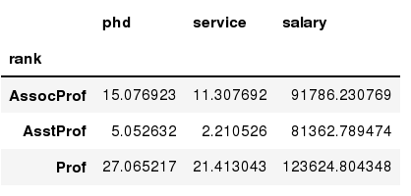
Data Frames groupby method
Using "group by" method we can:
Split the data into groups based on some criteria
Calculate statistics (or apply a function) to each group
Similar to dplyr() function in R
In [ ]:
#Group data using rank
df_rank = df.groupby(['rank'])
In [ ]:
#Calculate mean value for each numeric column per each group
df_rank.mean()

Slide 63
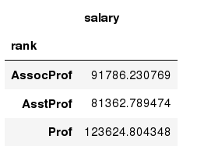
Data Frames groupby method
Once groupby object is create we can calculate various statistics for each group:
In [ ]:
#Calculate mean salary for each professor rank:
df.groupby('rank')[['salary']].mean()
Note: If single brackets are used to specify the column (e.g. salary), then the output is Pandas Series object. When double brackets are used the output is a Data Frame

Slide 64
Data Frames groupby method
groupby performance notes:
- no grouping/splitting occurs until it's needed. Creating the groupby object only verifies that you have passed a valid mapping
- by default the group keys are sorted during the groupby operation. You may want to pass sort=False for potential speedup:
In [ ]:
#Calculate mean salary for each professor rank:
df.groupby(['rank'], sort=False)[['salary']].mean()

Slide 65
Data Frame: filtering
To subset the data we can apply Boolean indexing. This indexing is commonly known as a filter. For example if we want to subset the rows in which the salary value is greater than $120K:
In [ ]:
#Calculate mean salary for each professor rank:
df_sub = df[ df['salary'] > 120000 ]
Any Boolean operator can be used to subset the data:
> greater; >= greater or equal;
< less; <= less or equal;
== equal; != not equal;
In [ ]:
#Select only those rows that contain female professors:
df_f = df[ df['sex'] == 'Female' ]

Slide 66
Data Frames: Slicing
There are a number of ways to subset the Data Frame:
one or more columns
one or more rows
a subset of rows and columns
Rows and columns can be selected by their position or label

Slide 67
Data Frames: Slicing
When selecting one column, it is possible to use single set of brackets, but the resulting object will be a Series (not a DataFrame):
In [ ]:
#Select column salary:
df['salary']
When we need to select more than one column and/or make the output to be a DataFrame, we should use double brackets:
In [ ]:
#Select column salary:
df[['rank','salary']]

Slide 68
Data Frames: Selecting rows
If we need to select a range of rows, we can specify the range using ":"
In [ ]:
#Select rows by their position:
df[10:20]
Notice that the first row has a position 0, and the last value in the range is omitted:
So for 0:10 range the first 10 rows are returned with the positions starting with 0 and ending with 9

Slide 69
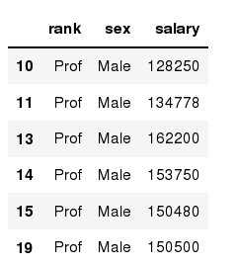
Data Frames: method loc
If we need to select a range of rows, using their labels we can use method loc:
In [ ]:
#Select rows by their labels:
df_sub.loc[10:20,['rank','sex','salary']]
Out[ ]:

Slide 70
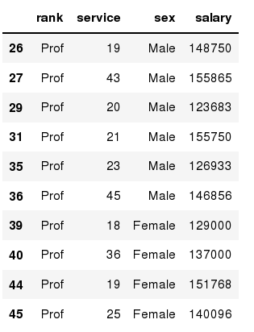
Data Frames: method iloc
If we need to select a range of rows and/or columns, using their positions we can use method iloc:
In [ ]:
#Select rows by their labels:
df_sub.iloc[10:20,[0, 3, 4, 5]]
Out[ ]:

Slide 71
Data Frames: method iloc (summary)
df.iloc[0] # First row of a data frame
df.iloc[i] #(i+1)th row
df.iloc[-1] # Last row
df.iloc[:, 0] # First column
df.iloc[:, -1] # Last column
df.iloc[0:7] #First 7 rows
df.iloc[:, 0:2] #First 2 columns
df.iloc[1:3, 0:2] #Second through third rows and first 2 columns
df.iloc[[0,5], [1,3]] #1st and 6th rows and 2nd and 4th columns

Slide 72
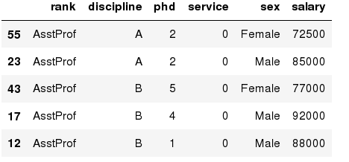
Data Frames: Sorting
We can sort the data by a value in the column. By default the sorting will occur in ascending order and a new data frame is return.
In [ ]:
# Create a new data frame from the original sorted by the column Salary
df_sorted = df.sort_values( by ='service')
df_sorted.head()
Out[ ]:

Slide 73
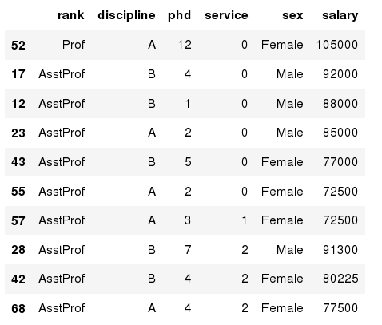
Data Frames: Sorting
We can sort the data using 2 or more columns:
In [ ]:
df_sorted = df.sort_values( by =['service', 'salary'], ascending = [True, False])
df_sorted.head(10)
Out[ ]:

Slide 74
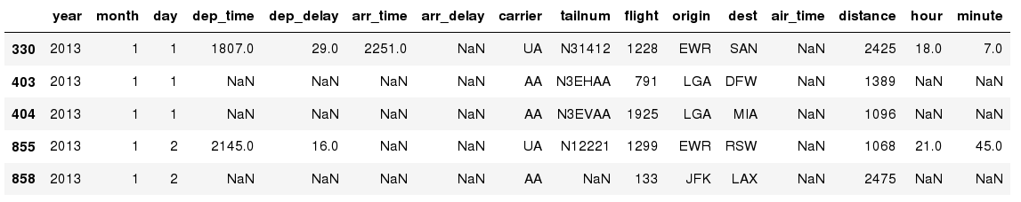
Missing Values
Missing values are marked as NaN
In [ ]:
# Read a dataset with missing values
flights = pd.read_csv("http://rcs.bu.edu/examples/python/data_analysis/flights.csv")
In [ ]:
# Select the rows that have at least one missing value
flights[flights.isnull().any(axis=1)].head()
Out[ ]:

Slide 75
Missing Values
There are a number of methods to deal with missing values in the data frame:
df.method() | description
dropna() | Drop missing observations
dropna(how='all') | Drop observations where all cells is NA
dropna(axis=1, how='all') | Drop column if all the values are missing
dropna(thresh = 5) | Drop rows that contain less than 5 non-missing values
fillna(0) | Replace missing values with zeros
isnull() | returns True if the value is missing
notnull() | Returns True for non-missing values

Slide 76
Missing Values
When summing the data, missing values will be treated as zero
If all values are missing, the sum will be equal to NaN
cumsum() and cumprod() methods ignore missing values but preserve them in the resulting arrays
Missing values in GroupBy method are excluded (just like in R)
Many descriptive statistics methods have skipna option to control if missing data should be excluded . This value is set to True by default (unlike R)

Slide 77
Aggregation Functions in Pandas
Aggregation - computing a summary statistic about each group, i.e.
compute group sums or means
compute group sizes/counts
Common aggregation functions:
min, max
count, sum, prod
mean, median, mode, mad
std, var

Slide 78
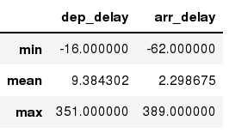
Aggregation Functions in Pandas
agg() method are useful when multiple statistics are computed per column:
In [ ]:
flights[['dep_delay','arr_delay']].agg(['min','mean','max'])
Out[ ]:

Slide 79
Basic Descriptive Statistics
df.method() | description
describe | Basic statistics (count, mean, std, min, quantiles, max)
min, max | Minimum and maximum values
mean, median, mode | Arithmetic average, median and mode
var, std | Variance and standard deviation
sem | Standard error of mean
skew | Sample skewness
kurt | kurtosis

Slide 80
Graphics to explore the data
Seaborn package is built on matplotlib but provides high level interface for drawing attractive statistical graphics, similar to ggplot2 library in R. It specifically targets statistical data visualization
To show graphs within Python notebook include inline directive:
In [ ]:
%matplotlib inline

Slide 81
Graphics
 | description
distplot | histogram
barplot | estimate of central tendency for a numeric variable
violinplot | similar to boxplot, also shows the probability density of the data
jointplot | Scatterplot
regplot | Regression plot
pairplot | Pairplot
boxplot | boxplot
swarmplot | categorical scatterplot
factorplot | General categorical plot

Slide 82
Basic statistical Analysis
statsmodel and scikit-learn - both have a number of function for statistical analysis
The first one is mostly used for regular analysis using R style formulas, while scikit-learn is more tailored for Machine Learning.
statsmodels:
linear regressions
ANOVA tests
hypothesis testings
many more ...
scikit-learn:
kmeans
support vector machines
random forests
many more ...
See examples in the Tutorial Notebook

Slide 83
Tasks
Make a Pandas DataFrame with two-dimensional list
Creating DataFrame from dictionary of 2 dimensional lists
Creating Pandas dataframe using list of lists
Creating a Pandas dataframe using list of tuples
Create a Pandas DataFrame from List of Dicts
Creating a dataframe from Pandas series
Reindexing in Pandas DataFrame

Slide 84
I HOPE YOU LEARN A LOT & ENJOY THE TRAINING! THANK YOU ☺

